Slide 1
Homeless Education Network Assessment & Community Feedback
September 18, 2015

Slide 2
Discussion Goals
Understand what types of networking activities best serve HEN participants
Discover other ways that HEN can be strengthened
Inform HCEF strategic planning for 2016-2018

Slide 3
What is the Homeless Education Network?
Notes:
The Homeless Education Network (HEN) is an alliance of community members working to improve educational opportunities and outcomes for children and youth (age 0-24) experiencing homeless in the Greater Pittsburgh area. The HEN is managed by the Homeless Children’s Education Fund with support from local foundations.
The HEN plans events that help participants to more effectively understand, identify, and address the educational needs of the homeless youth and families they serve, including:
Updating members on key policy, legislative, and funding issues that impact homeless youth
Sharing new research, data, and best practices in the field of homeless education
Linking diverse stakeholders through purposeful discussions around topics of shared concern
Increasing members’ awareness of local resources to support their clients
Supporting members in the development of collaborative projects and initiatives

Slide 4
Vision
Our whole community will work together to eliminate educational inequities faced by children, youth and families who experience homelessness in Allegheny County.

Slide 5
Inform Connect
Expose How? Elevate
Support Influence

Slide 6
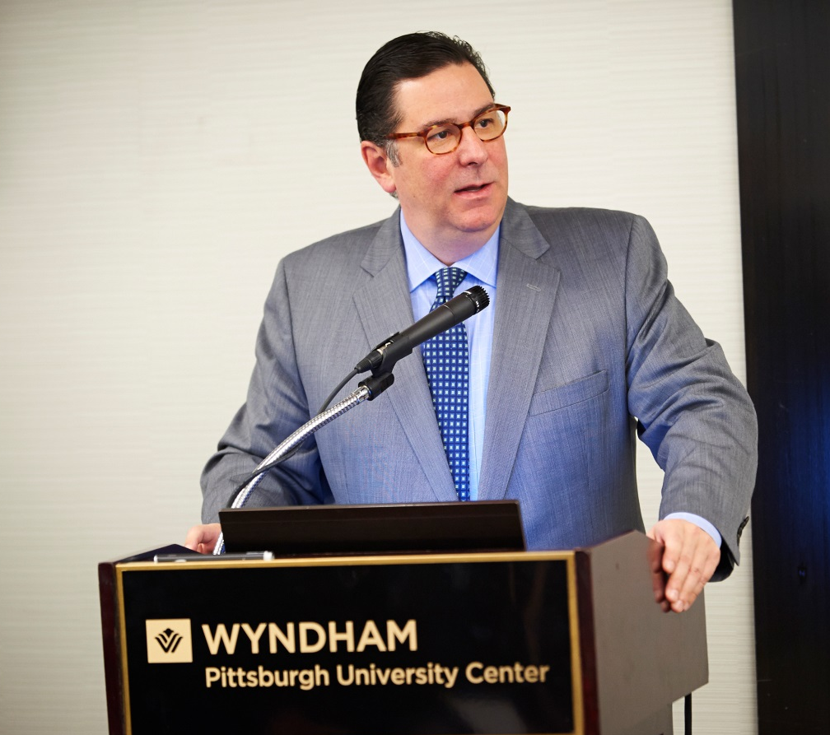
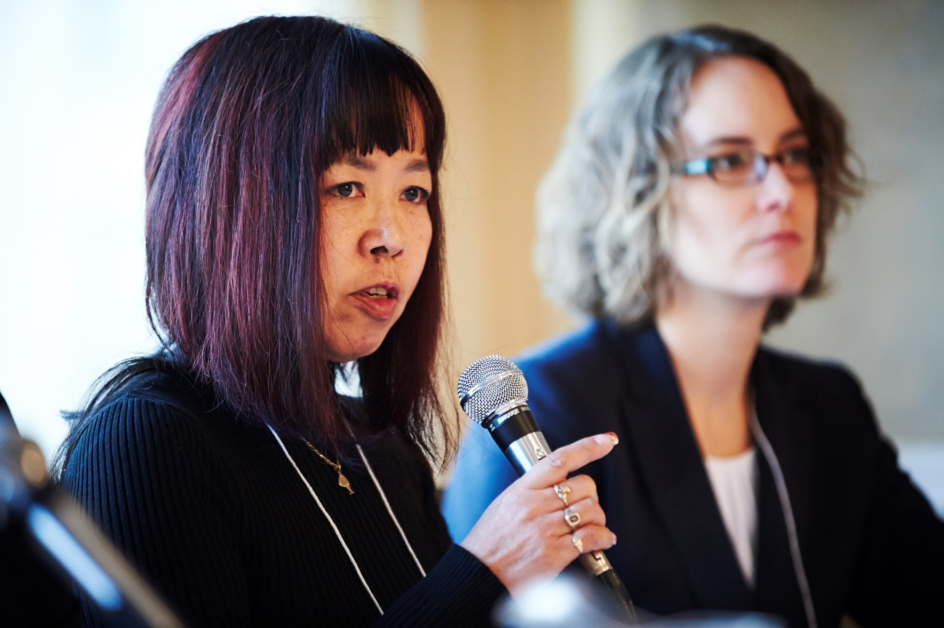
Faces of HEN

Slide 7
182 Organizations (2012-2015)
Notes:
495 individuals

Slide 8
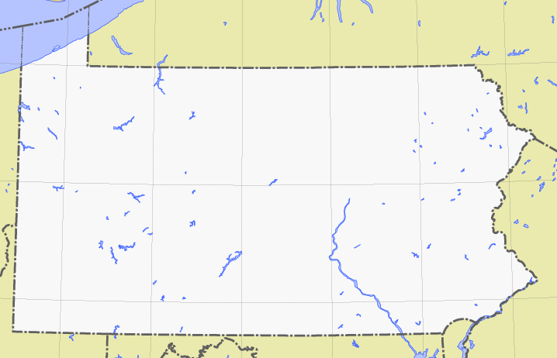
Regional Representation
8% Northern
Allegheny County
12% Eastern
Allegheny County
7% Pennsylvania
3% Western
Allegheny County
23% City of Pittsburgh
10% Southern
Allegheny County
2% N/A
1% National
34% Greater Pittsburgh Area (SWPA)

Slide 9
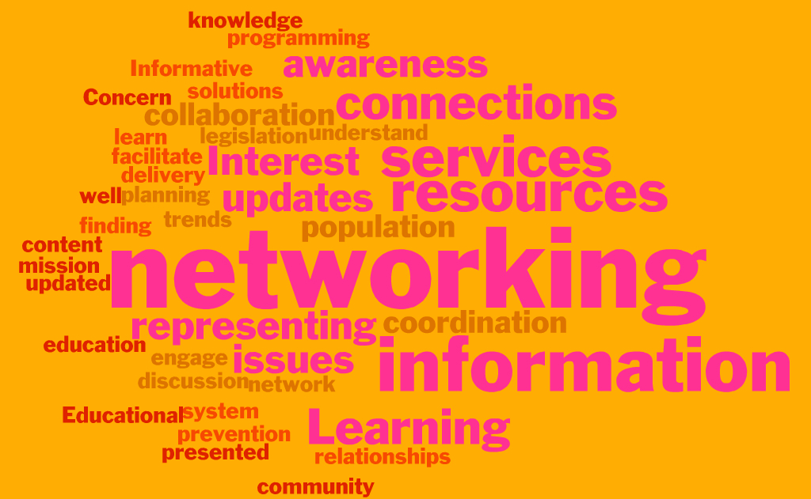
What are the main reasons you’ve attended HEN meetings or events in the past?

Slide 10
Which of the following has been a result of your participation in HEN?

Slide 11
Which of the following has been a result of your participation in HEN?

Slide 12
Has your participation in HEN had a positive impact on your work?
95% responded “Yes”
I am better equipped to deal with parents regarding their children’s education.
I have become much more aware and effective in working toward change.
I feel that part of my ability to advocate for this change [amendment of PA Act 212] was due, in part, to connections, exposure, information and collaborations through groups such as HEN…
I have become better educated about the resources available for children and families, legislation and how to advocate regarding that, and have made several connections with providers to better serve our families.

Slide 13
Which types of HEN activities would you like to see more of in the future?
Respondents were able to check multiple responses.

Slide 14
In the next 3 years, what outcomes to you hope the HEN will be able to accomplish?
Reduction in youth homelessness
More educational opportunities for youth
Increased school engagement in network
Expansion of network throughout state and region
Coordinate tracking and delivery of services
Implementation of standards of care across network
Involvement of individuals who have been homeless

Slide 15
Preliminary Takeaways
Update vision and objectives for next 3 years
Boost communications (Monthly e-Bulletin)
Build more quality networking time into meetings
Identify, promote and/or create training opportunities
Engage HEN members as leaders and drivers of system change

Slide 16
Discussion
What do you envision for the future of the Homeless Education Network? How can it be strengthened?

